Slide 1
Deploy AWS Serverless Application Model (SAM)
Reference : https://docs.aws.amazon.com/serverless-application-model/latest/developerguide/serverless-sam-cli-install-windows.html

Slide 2
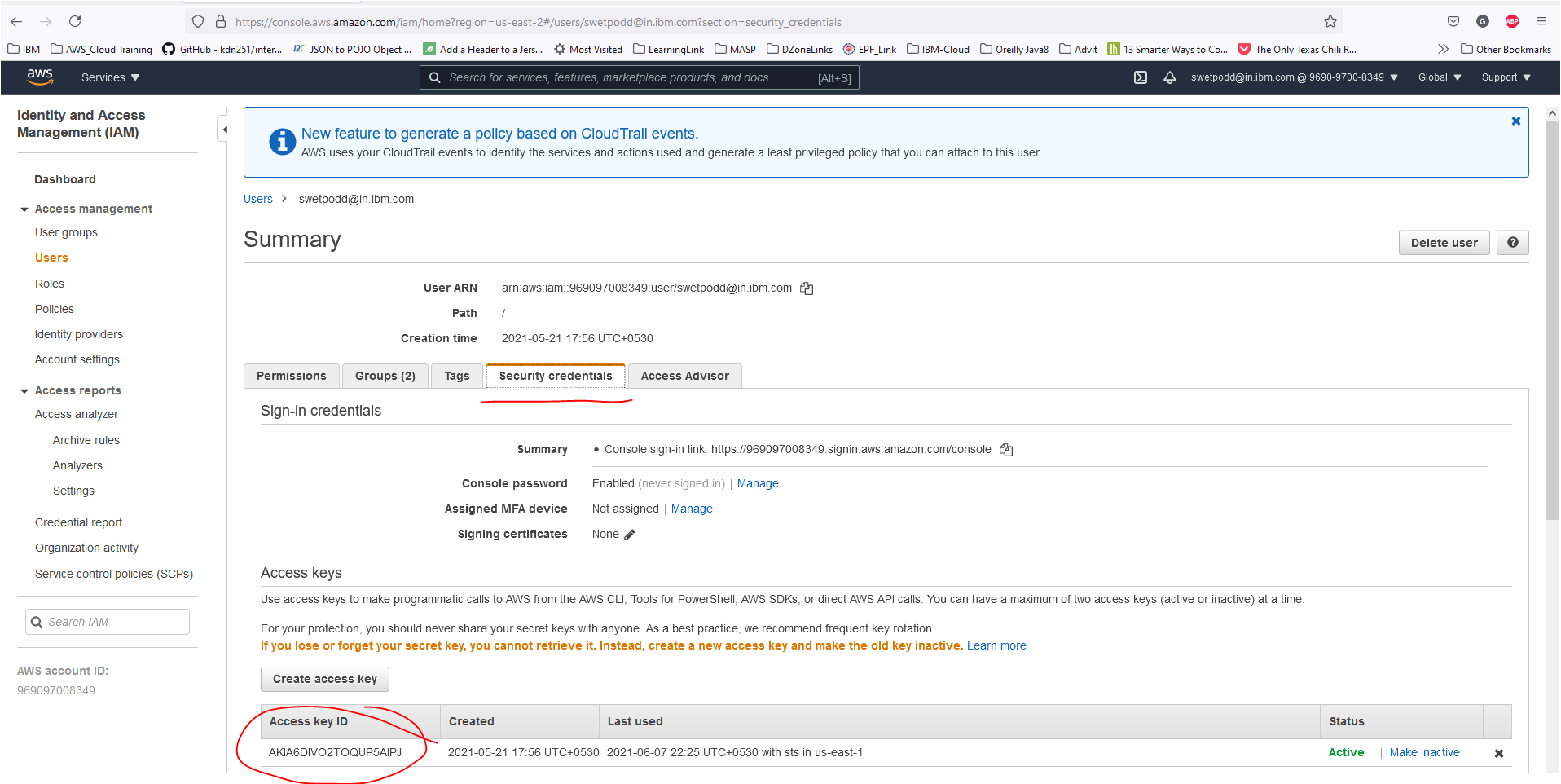
Get Security Credentials from AWS Console to login via local system

Slide 3
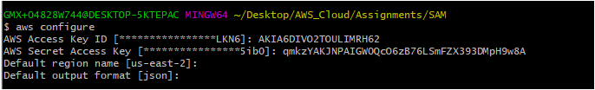
Login to AWS Console via local
$ aws configure

Slide 4
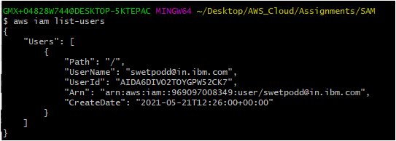
Check if you logged-in successfuly
$ aws iam list-users

Slide 5

Install AWS SAM CLI on Windows operating system and check the SAM version
$ sam –version

Slide 6
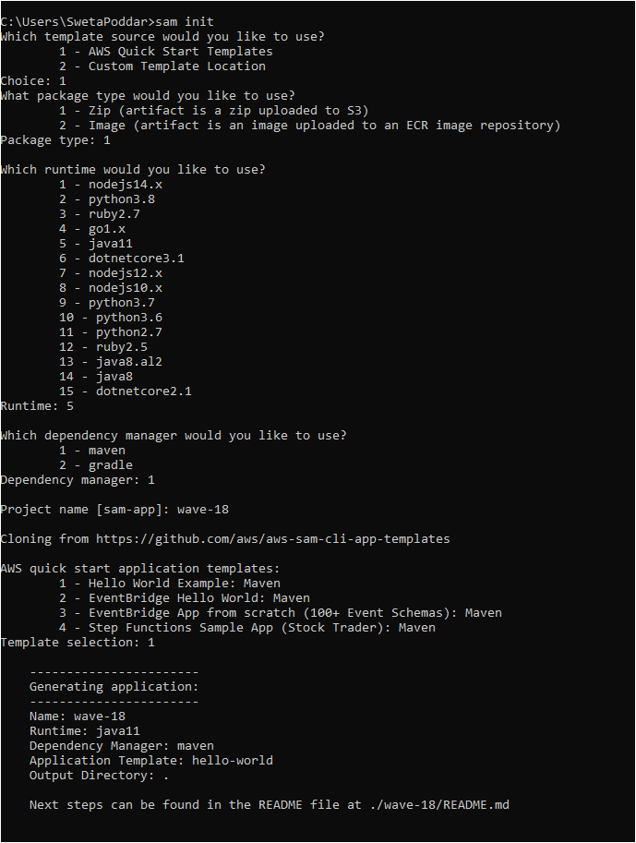
Step 1: Download a sample AWS SAM application
Run the below command to create the SAM template and enter corresponding template values
$ sam init

Slide 7
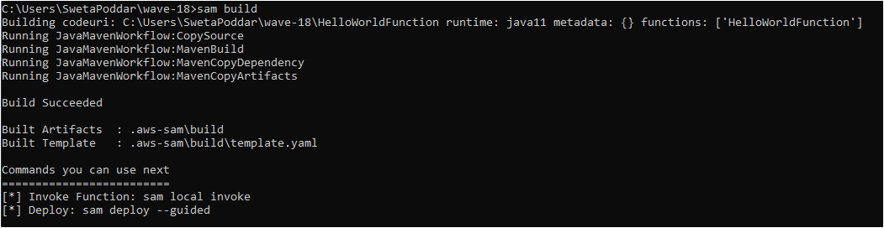
Step 2: Build your application
To build the serverless application as a .zip file archive, declare PackageType: Zip for the serverless function.
Go inside the <wave-18> folder & Run the below command
$ sam build

Slide 8
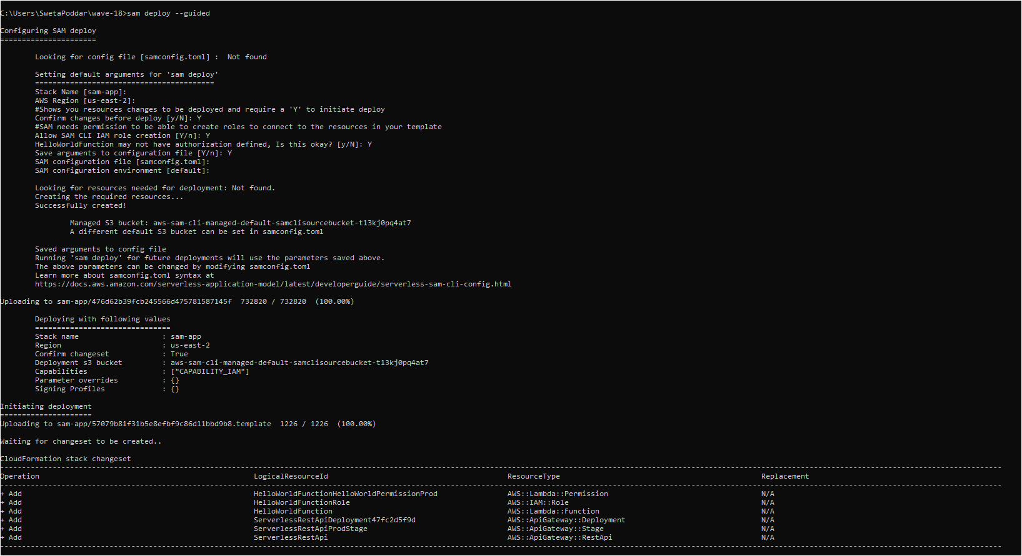
Step 3: Deploy your application to the AWS Cloud
$ sam deploy --guided

Slide 9
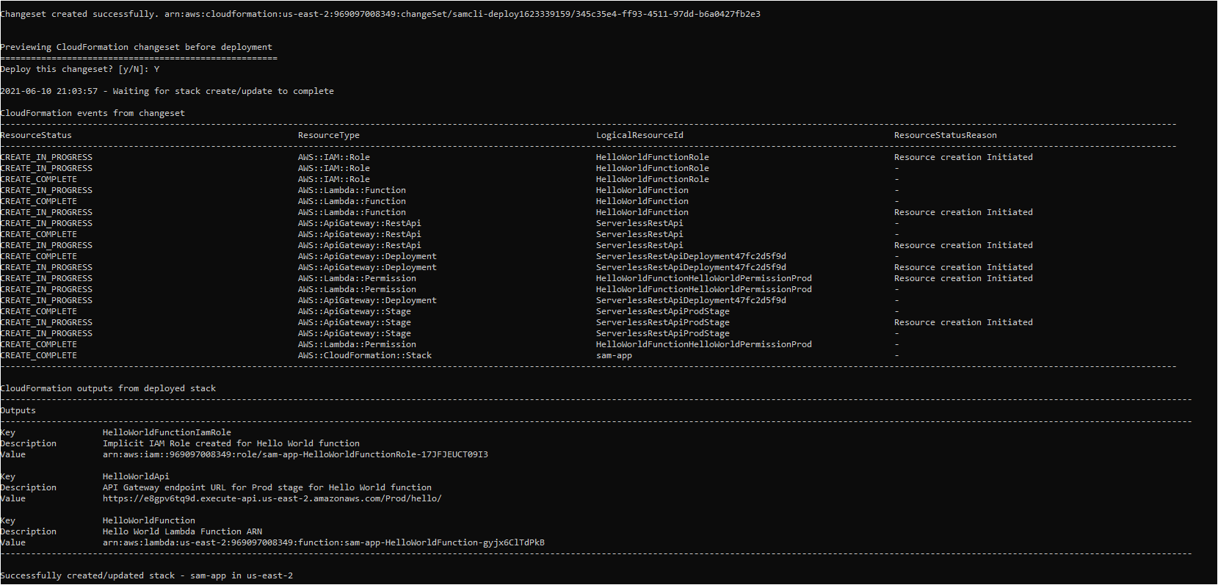

Slide 10
Now back to AWS Console..

Slide 11
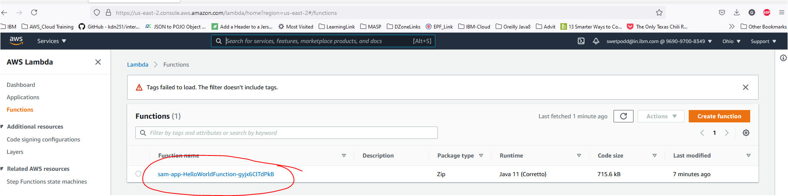
Step 01: Search for “Lambda”
This will show you the console where application is deployed..

Slide 12
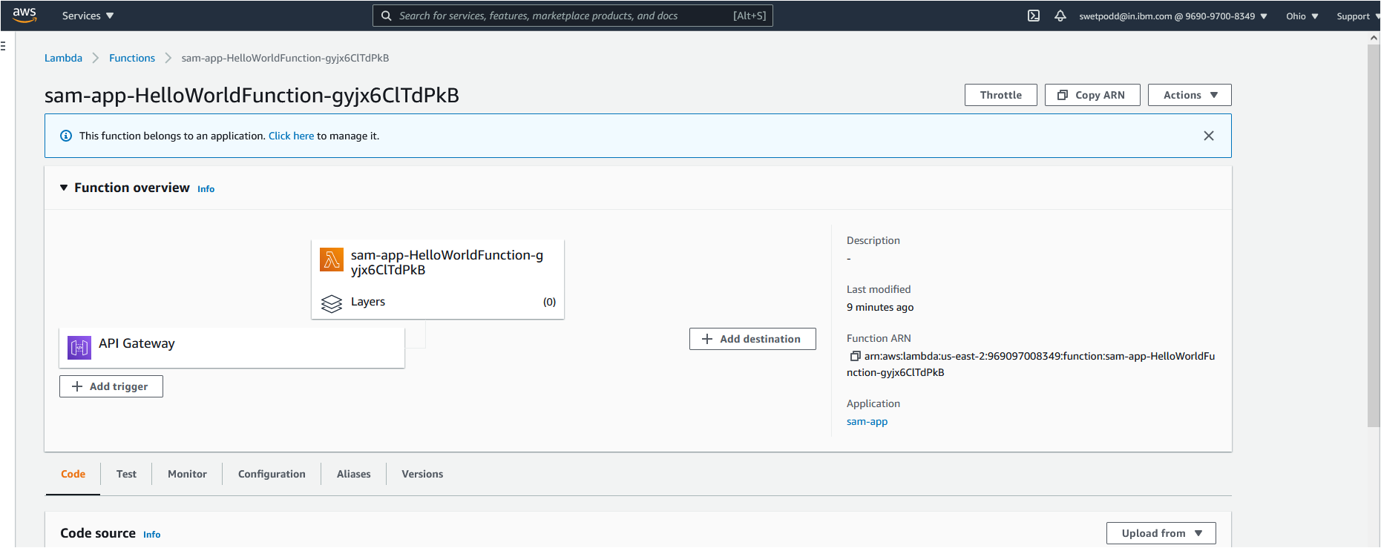
Step 02 : Click on the application

Slide 13
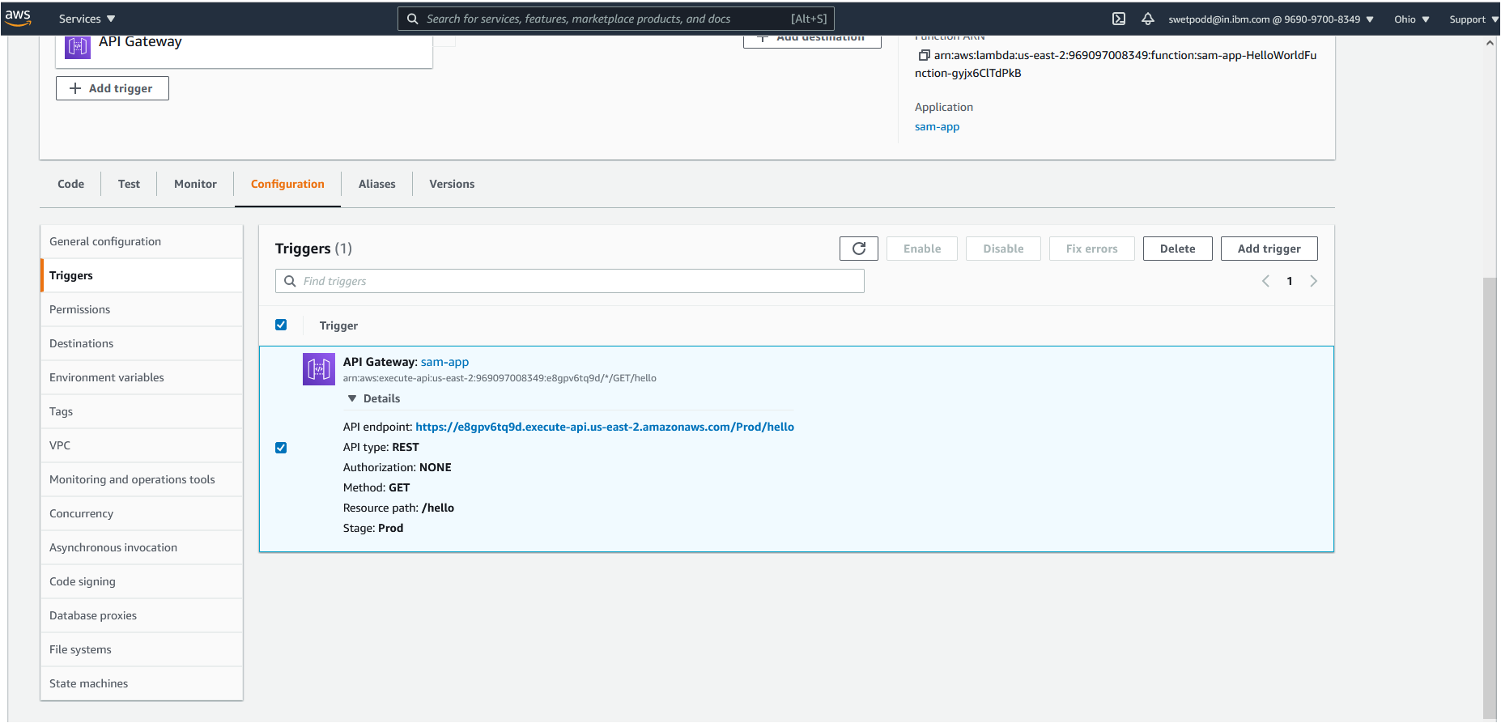
Step 03 : Click on ”Configuration” tab.

Slide 14
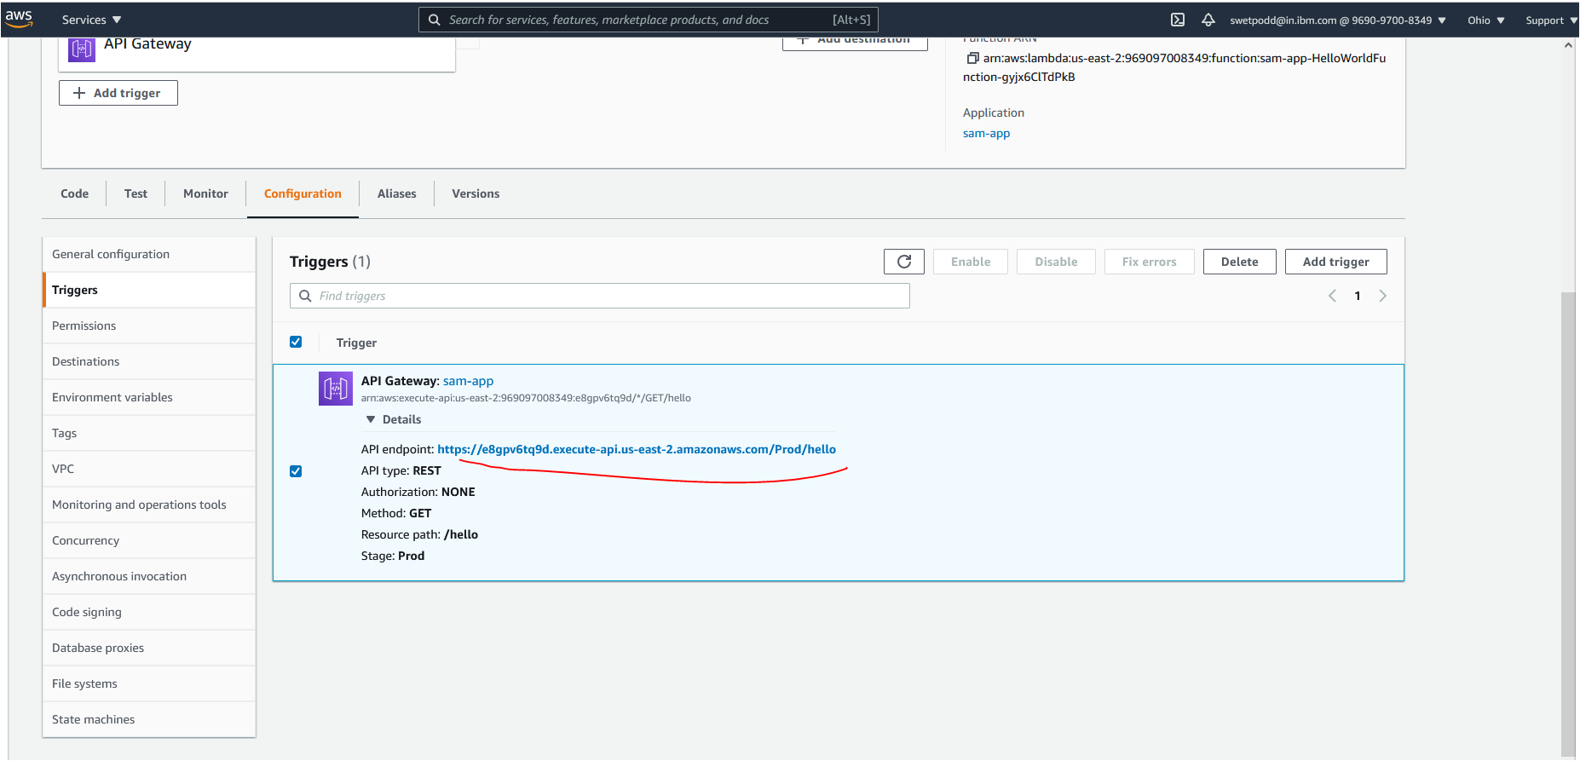
Step 04 : Now open –”API endpoint” in the browser.

Slide 15
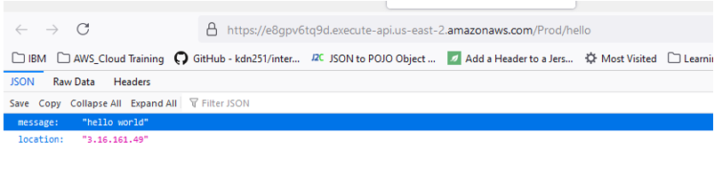
After successfully deploying the application, below output will show on browser

Slide 16
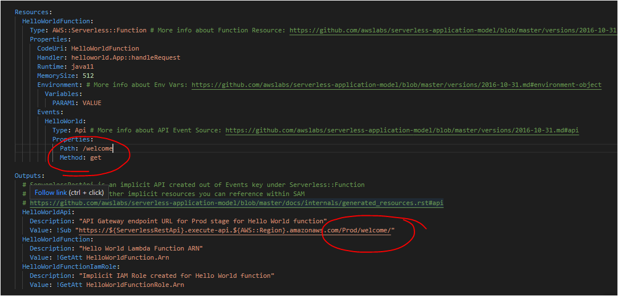
Step 05 : Now change path in “template.yml”

Slide 17
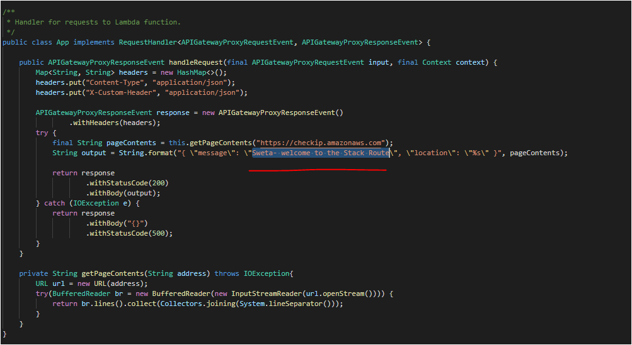
Step 06: Make changes in “HelloWorldFunction\src\main\java\helloworld”

Slide 18
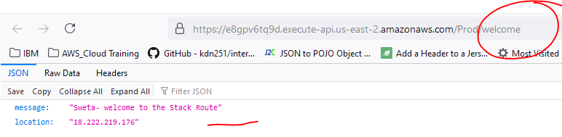
Step 07: Now “build” & “deploy” application like before to apply changes. Step 08 : Run it with changed URL path

Slide 19

The End
Compiled By,
SWETA PODDAR

